Slide 1
Understanding your scope of practice at advanced levels of practice
This resource is for use by HCPC registrants and those supporting this workforce. If using within your own presentations, please reference the original source. Some slides have additional notes provided which can also be used in your own work, with source recognition.
March 2026

Slide 2
Content
Scope of practice to meet the needs of different service user groups
What the HCPC standards say about scope of practice
Levels of practice
The evolving nature of scope of practice
Individual and profession scope of practice
Scope of practice and CPD
Reflective questions and identifying your next steps to support safe and effective delegation

Slide 3

An individual’s scope of practice can evolve to meet the needs of our broad range of service users
We use the term ‘service user’ as a broad phrase to refer to those who use or are affected by the services of professionals registered with the HCPC.
For example, people accessing services for their health, families, carers, colleagues, students, those you line manage and more.

Slide 4
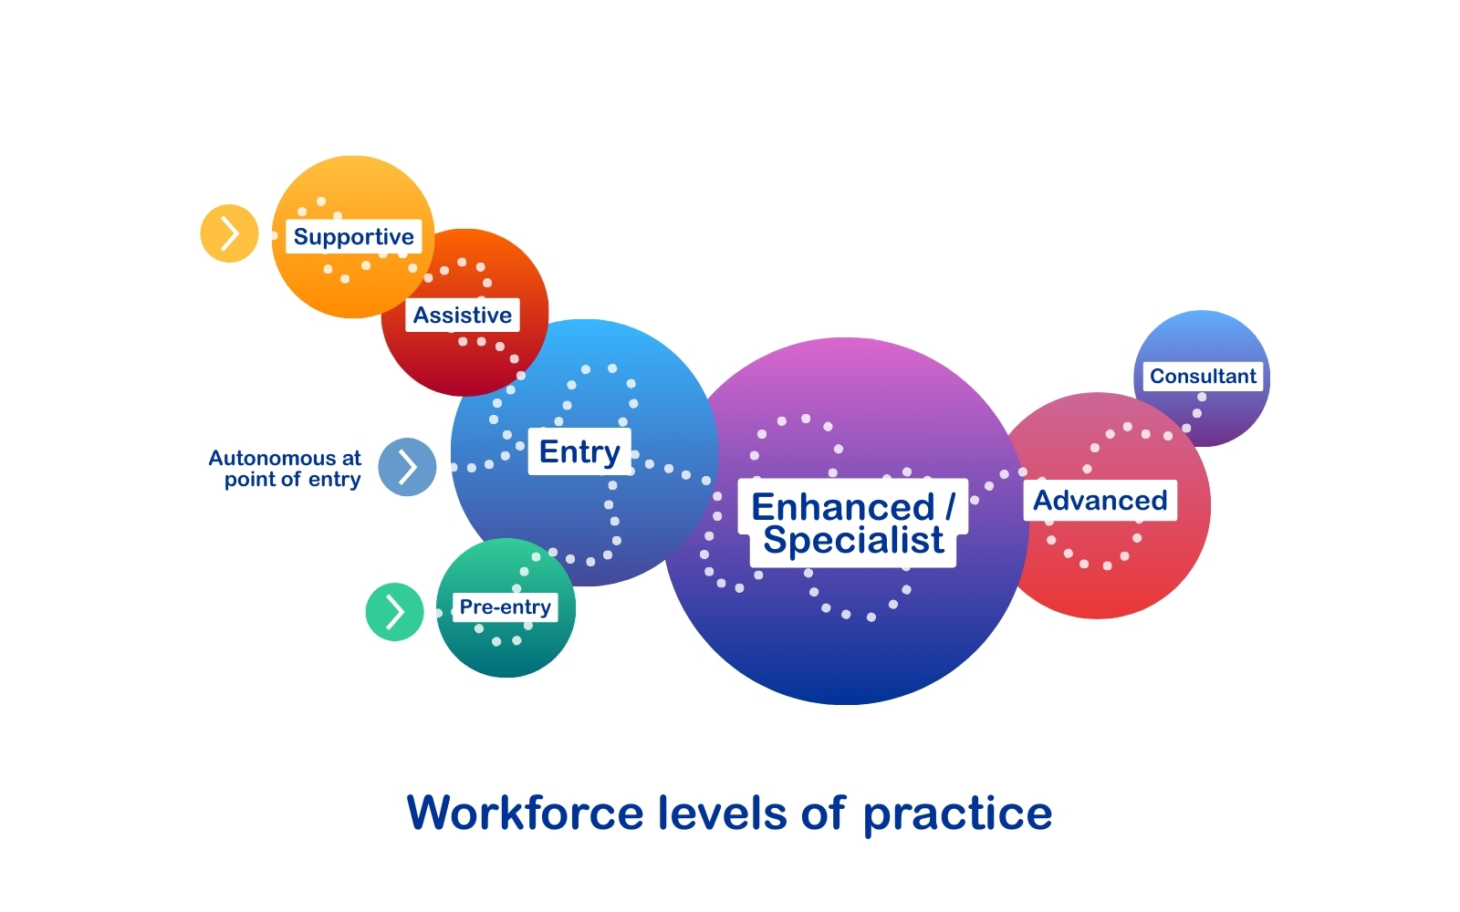

Levels of practice
Notes:
The levels of practice have been set out in national profession specific and multiprofessional frameworks and the terminology may differ slightly across countries and professions. The key takeaway points in relation to scope of practice include:
The levels of practice encompass many different roles across sectors
HCPC registrants are considered autonomous at the point of registration, working within the limits of their knowledge and skills and knowing when to refer to others
An individual’s scope of practice may appropriately evolve over time, with experience and additional training or qualifications, and with appropriate leadership oversight and governance
The levels of practice are a workforce development framework and not a regulatory requirement
Working within scope of practice is a regulatory requirement

Slide 5


Reflective questions and any further actions?
How would you describe your level of practice?
How could you evidence your level of practice? (e.g. refer to resources from your professional body or UK country specific resources)
Are there any additional actions you would like to consider?

Slide 6
HCPC standards for scope of practice
Standards of conduct, performance and ethics
3.1 You must only practise in the areas where you have the appropriate knowledge, skills and experience to meet the needs of a service user safely and effectively
3.2 You must undertake additional training to update your knowledge, skills and experience if you wish to widen your scope of practice​
3.3 You must refer a service user to an appropriate practitioner if the care, treatment or other services they need are beyond your scope of practice. This person must hold the appropriate knowledge, skills and experience to meet the needs of the service user safely and effectively
Notes:
​The Standards and associated guidance for scope of practice are there to support registrants to work safely and effectively. ​This is what the HCPC standards say about scope of practice. Note how the standards require registrants to undertake additional training but do not mandate that this must be a specific type e.g. a formal qualification, as this will be dependent on the individual context.
The Standards refers to the broader definition of service user which means that some of your additional qualifications and / or training may be linked to broader learning e.g. leadership and change management, should your role require those elements.
To work within scope of practice registrants must take responsibility and accountability for their decisions and actions. There are also responsibilities for other people such as employers who need to have in place policies and processes to support people to work within their scope of practice.
​

Slide 7
Scope of practice evolves with you and requires you to use your professional judgement
As you progress in your career, you may enter into more specialist practice roles where not all the standards of proficiency are relevant to your scope. Your scope of practice will develop with you and may become narrower.
Determining what is and is not part of your scope of practice will be for you to decide using your professional judgement.
Identifying your current scope of practice | The HCPC
Notes:
This statement encapsulates the point about scope of practice functioning as a living and evolving concept – it develops with you and requires you to use your professional judgement about what you and / or your profession can do. This statement speaks to scope of practice narrowing over time but it can also broaden depending on the needs of your service users. The link in the presentation will direct registrants to additional resources to support you to identify their scope of practice.

Slide 8






Support for professional judgement
When​ thinking about your scope of practice, ask yourself the following:
Do I have the skills and knowledge to carry out the activity safely and effectively?
Can I complete training or receive other support (such as supervision) that will give me the skills and knowledge needed to carry out the activity safely and effectively?
Is the activity restricted by law (e.g. prescribing) and, if so, can I legally do it?
Does my professional indemnity insurance cover the activity?
Notes:
If you have queries about your scope of practice, you may want to think where is best to take your question. You may need to reflect on the extent to which you have the knowledge and skills for the activity and if you need additional training / learning to aid safe and effective practice. Is this a question about whether you are legally allowed to do something, is it a regulatory question, one specific to your profession, or bound by the regional / local policies of your workplace? It may be that you need to consult your line manager, your strategic lead (if you are in an employing organisation), your professional body and / or your regulator to seek answers for specific questions to guide your professional judgement.

Slide 9
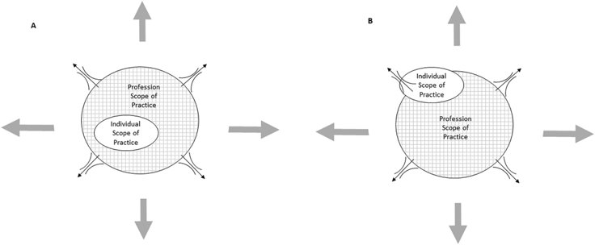
The evolving nature of scope of practice (see slide notes for more information)
These diagrams show how an individual scope of practice evolves during a registrant's career and how that interacts with the scope of their profession
How can scope of practice be described and conceptualised in medical and health professions? A systematic review for scoping and content analysis - Downie - 2023 - The International Journal of Health Planning and Management - Wiley Online Library
Notes:
This diagram is from the reference on the slide and there are similar elsewhere including from professional bodies. The diagram shows the following:
The two inter-related elements to scope of practice – individual and profession
How scope of practice evolves with time and experience including, where appropriate, beyond the generally accepted boundaries of the origin profession
As registrants advance in their careers, the individual scope of practice grows and may extend beyond the generally accepted boundaries of the origin profession to meet service user needs. These individual registrants must continue to work within the boundaries of their individual knowledge, skills and capabilities and contracts of employment (for those in substantive posts). Furthermore, an individual’s scope of practice should not develop in isolation, rather an expanded role must be developed because it addresses a service need, and (for those in employing organisations) with organisational oversight, underpinned with workforce planning. The latter includes considering the impact on the wider service to ensure the sustainability of expanded roles.

Slide 10
Reflective questions and any further actions?
How do you conceptualise your scope of practice in relation to your profession?
How do you define and demonstrate your scope of practice including through supervision, experiences, training and additional qualifications?
Are there any additional actions you would like to consider?

Slide 11

What do we mean by scope optimisation?
Our scope of practice evolves over time depending on the context of our work.
Scope optimisation:
Making the best use of our time, knowledge and skills to benefit the people we serve, within the context of our work, while working within our scope of practice​.
Notes:
Scope optimisation is ‘a concept that helps us make the best use of our time, knowledge and skills to benefit the people we serve’. This puts it within the context of our workplace – registrants should primarily seek to optimise their scope to meet the needs of their service users. And optimise the scope of practice for all members of the workforce, including support workers and technicians.

Slide 12
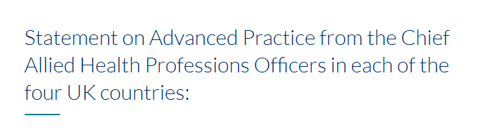
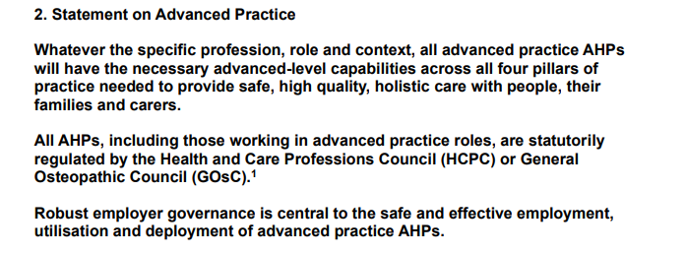
Advanced practice
Other reading
four-country-ap-statement-oct-2024.pdf
Notes:
In addition to the resources provided by HCPC, there are a range of resources, across the UK countries, to support you to define and demonstrate your scope of practice.
For the Advanced Level of Practice only: there is a statement on Advanced Practice from the Chief Allied Health Professions Officers in each of the four UK countries. They collaborated on it to provide clarity about how advanced practice for AHPs is defined, regulated and governed

Slide 13
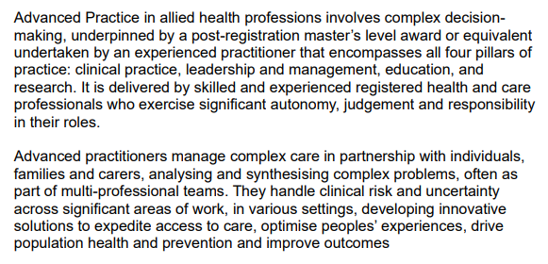
Advanced practice
Other reading
four-country-ap-statement-oct-2024.pdf
Notes:
The statement provides an agreed definition of Advanced Practice for AHPs – it aligns with definitions that are country specific and other multi and uni-professional definitions too.

Slide 14
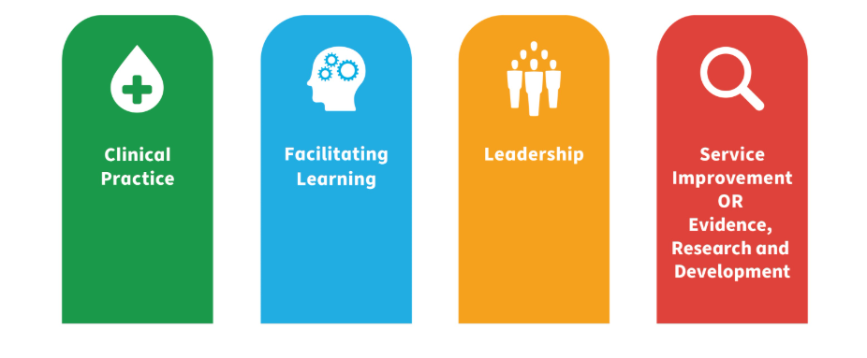
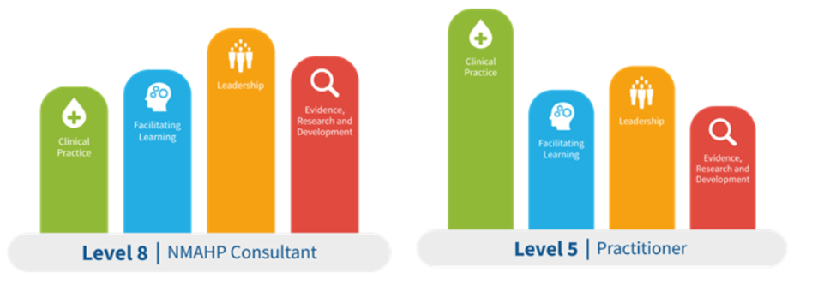
Four Pillars of Practice
NHS Education Scotland, 2025
Notes:
The Four Pillars of Practice are Clinical Practice, Facilitating Learning, Leadership, Evidence, research and development. This slide shares the version from NHS Education Scotland and again there is some variation in terminology used in different UK countries and professional bodies.
The size of each pillar will depend on your role, driven by the needs of the service and level of practice as shown here. The pillars can go up and down as your scope of practice evolves e.g. if a registrant moves from clinical practice into a full-time academic role, their clinical pillar may go down over time while their facilitating learning pillar will rise substantially.
The Four Pillars of Practice are not compulsory from a regulatory perspective, but they can act as a guide when thinking about optimising your scope of practice to support your professional development to benefit the people you serve.

Slide 15
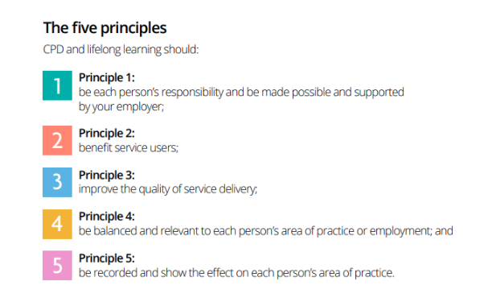
Multiprofessional CPD principles
Other reading
CPD is not just a ‘nice to have’: Why everyone in the system should support CPD | The HCPC
Broughton W and Harris G. (2022) (Eds.)
Notes:
The notion that CPD must be aligned to our scope of practice is widely agreed across healthcare professions. These five principles are from CPD Together – encompassing a collective voice from over 20 different health and care professional bodies (and trade unions) including nursing, midwifery and many of the professions regulated by HCPC. Principle 4 – CPD and lifelong learning should be balanced and relevant to each person’s area of practice or employment – confirms the importance of aligning CPD with scope of practice.

Slide 16
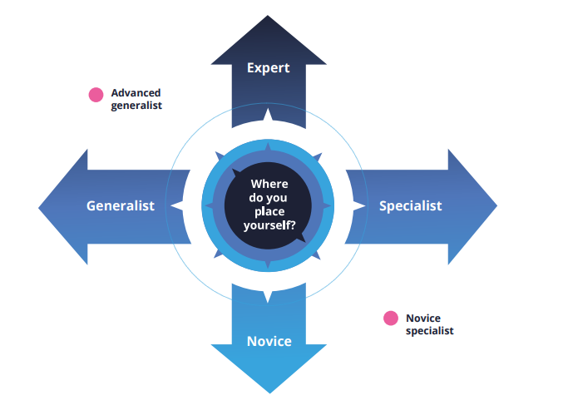
Specialist versus generalist
Royal College of Speech and Language Therapists, 2023
Notes:
This figure is from the Royal College of Speech and Language Therapists Professional Development Framework but you will also see a version of it in other places.
Notice the horizontal axis of generalist to specialist in particular. This diagram helps registrants to understand that scope of practice can be specialist e.g. working in a specialty such as neurosciences within an origin profession or building on your origin profession with additional learning and training e.g. to work in multiprofessional roles such as an advanced clinical practitioner. We can also work towards advanced generalist practice e.g. in primary care or the broader (non-specialist) elements of social care. The vertical arrows show the levels of practice.

Slide 17
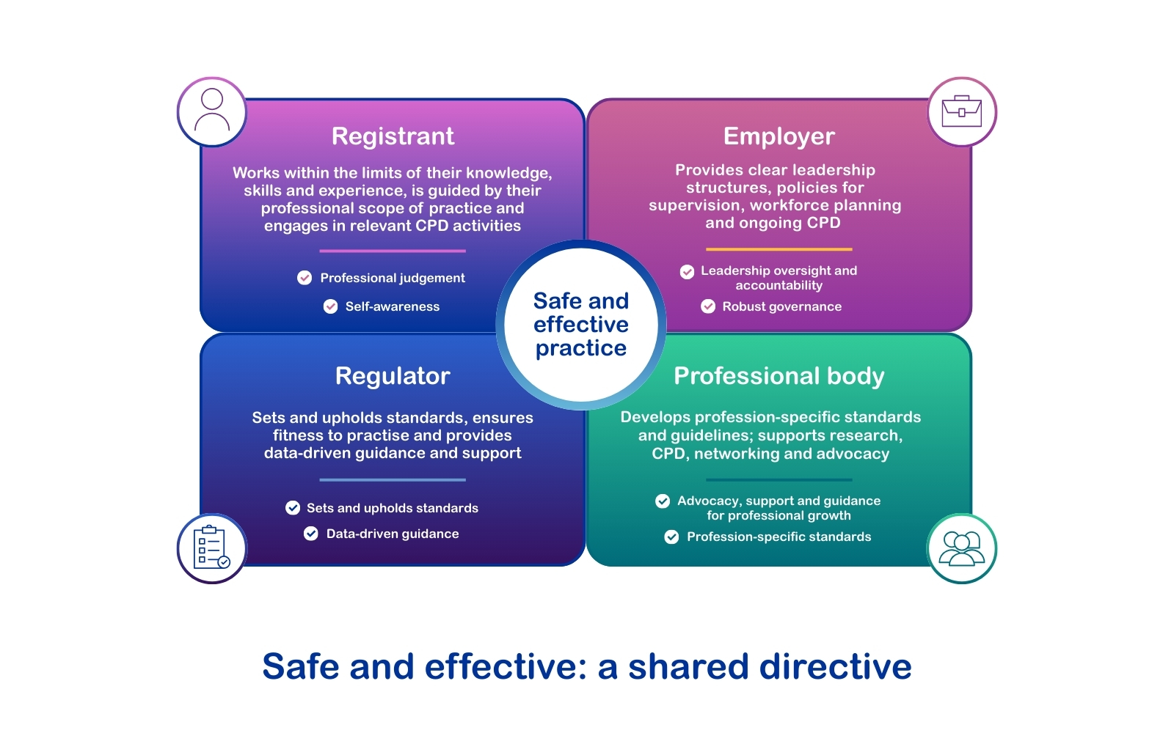
Notes:
As discussed, our scope of practice is an evolutionary process and one which happens within the context of work. Therefore defining, maintaining and supporting safe practice, for those registrants who are in substantive posts, also requires input from employing organisations too.
Being safe and effective is a shared directive. It’s a partnership between registrants, employers, regulators (health and care regulators and system regulators) and professional / national bodies for every level of practice. All working together within the broad legal framework as described here.
​

Slide 18
Recap: putting it all together
Levels of practice are important formal structures in employment and regulatory standards apply across all of them.
The HCPC standards and scope of practice guidance apply to all registrants irrespective of their job title or seniority within an organisation.
There is no separate, additional regulatory framework or set of standards for registrants working at higher levels.
Developing into more advanced levels of practice means developing new skills, working with greater autonomy and complexity across the four pillars of practice, guided by service user needs. Your CPD should reflect this.
Safe and effective practice, including as you optimise your scope of practice, requires active input from the registrant, the employer, the profession and the regulator.

Slide 19
Reflective questions and any further actions?
Are there any additional actions you would like to consider?
Identify a small number of actions you can do within the next fortnight to continue to support safe and effective delegation.
What are your key learning points in relation to your scope of practice and / or those who you line manage?

