Slide 1
Supervision at advanced levels of practice: what the standards say and reflective questions to guide practice
This resource is for use by HCPC registrants working at advanced levels of practice and those supporting this workforce. If using within your own presentations, please reference the original source. Some slides have additional notes provided which can also be used in your own work, with source recognition.
March 2026

Slide 2
Content
What the HCPC standards say about supervision
What the HCPC standards say about scope of practice
Clarifying the nature of supervision inc. different types
The key characteristics of supervision
Resources to support supervision at advanced levels of practice
Reflective questions and identifying your next steps to engage in meaningful supervision

Slide 3
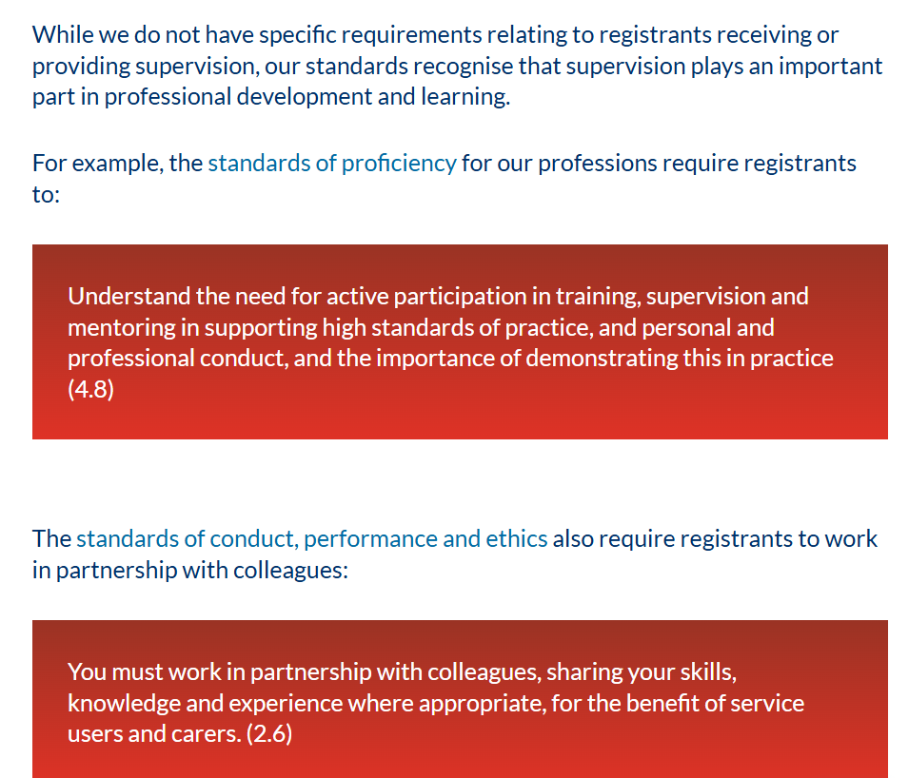
HCPC standards for supervision
What our standards say | The HCPC

Slide 4
Supervision to support registrants to reflect on, define and explain their scope of practice
Standards of conduct, performance and ethics
3.1 You must only practise in the areas where you have the appropriate knowledge, skills and experience to meet the needs of a service user safely and effectively
3.2 You must undertake additional training to update your knowledge, skills and experience if you wish to widen your scope of practice​
3.3 You must refer a service user to an appropriate practitioner if the care, treatment or other services they need are beyond your scope of practice. This person must hold the appropriate knowledge, skills and experience to meet the needs of the service user safely and effectively
Notes:
​Effective supervision provides space for registrants to reflect on their scope of practice and consider ways to appropriately evolve it to meet service user needs, alongside identifying additional training they may wish to take to widen their scope of practice.
​

Slide 5

Supervision benefits the wider service and service users
We use the term ‘service user’ as a broad phrase to refer to those who use or are affected by the services of professionals registered with the HCPC.
For example, people accessing services for their health, families, carers, colleagues, students, those you line manage and more.

Slide 6
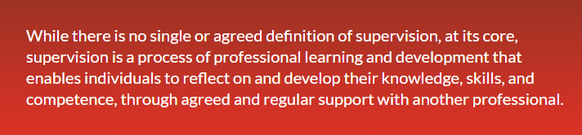
Supervision: Key points to consider
Supervision is a core component of maintaining safe and effective practice in all sectors and settings
There are different types of supervision
Supervision can have significant benefits for the wider service and service users
Active learning and continuing professional development activities are required to be an effective supervisor and supervisee
Some registrants may be supervised by people from outside of their origin profession

Slide 7


Reflective questions and any further actions?
List all your service user groups?
How does / could supervision support you to be safe and effective across all the groups of people you serve?
How do you capture the impact and benefits of supervision for yourself and for your service users?
Are there any additional actions you would like to consider?

Slide 8




Different types of supervision
(see descriptions in the notes)
Notes:
Actively participating in any form of supervision can form part of your CPD activities so long as you can show the impact it has on developing your practice.
There are different types of supervision including:
direct and in-direct supervision
cross-profession supervision
multiple supervisors for different aspects of work
line management supervision
peer supervision
group supervision
professional development supervision
education-based / academic supervision (e.g. for post registration learners on advanced practice programmes)
Supervision is not always about watching someone do their work directly alongside them. Technology is now being used to offer direct and in-direct remote supervision too (especially relevant for registrants in remote and rural settings). You may have one supervisor who provides different types of supervision e.g. line management and professional development or you may have different supervisors for different needs.
In short, the type of professional support, including supervision and other forms, are dependent on the needs of individual registrants and the policies and processes within an organisation (for those who work within them). To reiterate, all forms of supervision act as an essential mechanism for safe and effective practice.

Slide 9

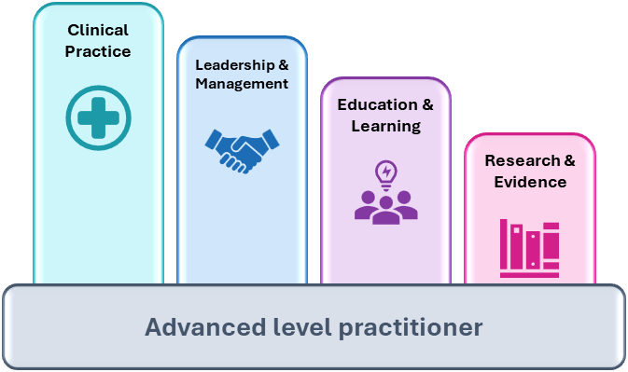
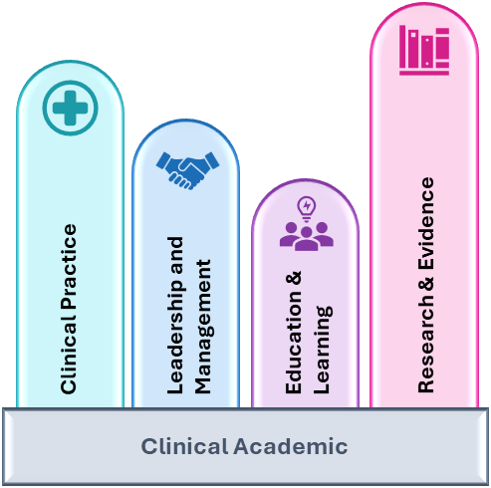

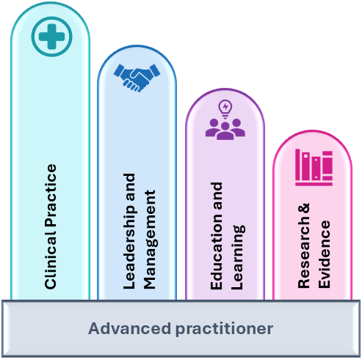
Supervision across the four pillars of practice
NB: pillar size is an illustrative example only and does not reflect every role at the advanced level
Notes:
The four pillars of practice are a key feature at the advanced levels of practice, and you may need to consider how your supervision arrangements support your development across all four of them.

Slide 10
What supervision is not
There are different types of professional development support that should not be confused with supervision:
Preceptorship
Induction / onboarding
Probation
Mentoring
Counselling
For further details:
Differences between preceptorship and other forms of support | The HCPC
Notes:
There is a range of mechanisms that provide professional support in addition to supervision.
It is important to understand the different mechanisms for support, including so you remain within your scope of practice as a supervisor. There may be techniques used within supervision that come from the mentoring, coaching or counselling but these are separate roles and professions e.g. counselling is beyond the scope of practice for a supervisor. This does not mean that the additional needs of a needs are ignored – the supervisor's role in this situation would be to advise and refer on if necessary.

Slide 11
Reflective questions and any further actions?
Are there any additional actions or types of supervision you would like to consider?
How do your current supervision arrangements support you across all four pillars of practice?

Slide 12
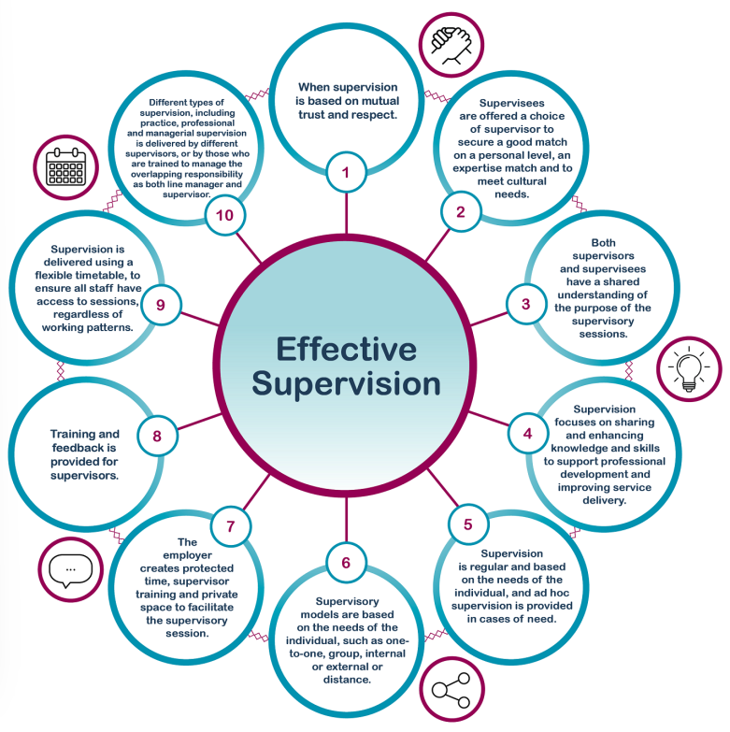
Key characteristics of effective supervision
Key characteristics of effective supervision | The HCPC
Notes:
Research commissioned by HCPC from Newcastle University identified 10 key characteristics for effective supervision – these characteristics can help you as an experienced practitioner to reflect on your current experiences and identify ongoing areas for development. The link on the slide will take you to the webpage for further information.

Slide 13
Reflective questions and any further actions?
Are there any additional actions you would like to consider to support you to be an effective supervisor and / or supervisee?
Reflect on the key characteristics in relation to the supervision you receive and the supervision you provide?

Slide 14
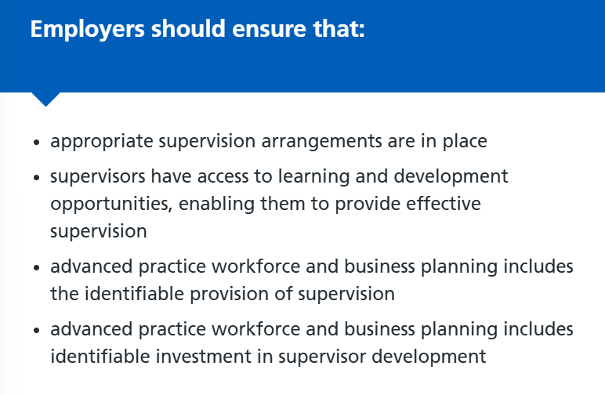
Supervision for experienced advanced practitioners
Centre for Advancing Practice, 2025
Notes:
Employers also have a responsibility to ensure access and provision of supervision through their policies and practices.

Slide 15
Reflective questions and any further actions?
Are there any additional actions you would like to consider?
If you are employed within an organisation, how familiar are you with the policies and processes to support effective supervision?

