Slide 1
Delegation: what the standards say and reflective questions to guide practice
This resource is for use by HCPC registrants and those supporting this workforce. If using within your own presentations, please reference the original source. Some slides have additional notes provided which can also be used in your own work, with source recognition.
March 2026

Slide 2
Content
Clarifying the purpose of delegation
What the HCPC standards say about delegation
Accepting delegated activities – what the HCPC standards say about scope of practice
Delegating to others – questions to consider
Delegating across the four pillars of practice
Reflective questions and identifying your next steps to support safe and effective delegation

Slide 3

The purpose of delegation is to benefit service users
We use the term ‘service user’ as a broad phrase to refer to those who use or are affected by the services of professionals registered with the HCPC.
For example, people accessing services for their health, families, carers, colleagues, students, those you line manage and more.
When delegating an activity to another person, it must be because doing so benefits service users.

Slide 4


Reflective questions and any further actions?
List all your service user groups?
What do you already delegate to and how does this benefit your service users?
How do you capture the impact and benefits of the work you currently delegate?
Are there any additional actions you would like to consider?

Slide 5
HCPC standards for delegation
Standards of conduct, performance and ethics
4.1 You must only delegate work to someone who has the knowledge, skills and experience needed to carry it out safely and effectively.
4.2 You must continue to provide appropriate supervision and support to those you delegate work to.
Notes:
The HCPC regulates individual registrants therefore the standards speak directly to them. These are the standards for delegation. You will note there isn’t a specific list of delegated activities from the perspective of the regulator. Some organisations may choose to provide a list of delegated activities, and this is part of organisational governance.
These standards must be interpreted within a broader context. HCPC sets standards for registrants but the responsibility to meet them requires support. The obligations do not lie solely with the registrant / person who is doing the delegation to another person e.g. a support worker. If delegation occurs within organisations, then employers (including service managers and strategic leaders) also have a responsibility to support safe and effective delegation e.g. through local organisational policies and processes to support delegation, e.g. as set out in the CQC regulatory framework.
Equally, the person being delegated to has a responsibility to make a judgement on whether they feel able to accept the delegated activity, appreciating that this is sometimes a challenge.
If you are delegating to another registrant, the activities must be based within their individual scope of practice, alongside their job description.
If you are delegating to a support worker or carer, they must feel confident that the delegated activity sits within their job description and individual capabilities. It is the latter example in particular where we need to be mindful of power dynamics.
Delegation is as a relational activity rather than a transactional one.

Slide 6
HCPC standards for scope of practice
Standards of conduct, performance and ethics
3.1 You must only practise in the areas where you have the appropriate knowledge, skills and experience to meet the needs of a service user safely and effectively
3.2 You must undertake additional training to update your knowledge, skills and experience if you wish to widen your scope of practice​
3.3 You must refer a service user to an appropriate practitioner if the care, treatment or other services they need are beyond your scope of practice. This person must hold the appropriate knowledge, skills and experience to meet the needs of the service user safely and effectively
Notes:
​The Standards and Scope of Practice guidance are there to support you including when work is being delegated to you. ​This is what the HCPC standards say about working within the limits of your knowledge, skills and experience. Note how the standards require you to undertake additional training but do not mandate that this must be a specific type e.g. a formal qualification, as this will be dependent on your context.
The Standards refers to the broader definition of service user which means that some of your additional qualifications and / or training may be linked to broader learning e.g. leadership and change management, should your role require those elements.
To work within our scope of practice we must take responsibility and accountability for our decisions and actions. There are also responsibilities for other people such as employers who must have in place policies and processes to support delegation and scope of practice.
​

Slide 7

Delegating within the workforce – the need for local policies and processes to make the most of the knowledge and skills within the team
Service needs
Support
Preceptorship
Foundation
Enhanced
Advanced
Consultant
Notes:
Delegation supports us to make the most out of the knowledge and skills within the team. It can support the effectiveness and efficiency of service delivery. Safe and effective delegation requires local policies and processes to act as a guide including the provision of ongoing support and supervision for the person being delegated to.

Slide 8
Delegation: Practical points to consider
Delegation is a core component of maintaining safe, productive and efficient practice – it is a mutual legal duty between the employer, the person delegating and the person being delegated to.
Active learning / continuing professional development is required to support safe and efficient delegation, including delegating to others and being delegated to.
Some registrants may be delegating activities to people outside of their organisation e.g. care workers.
There may be unseen power dynamics in the delegation process that need to be considered.
Delegation is a relational activity, and individuals must feel supported. It is an on-going process that requires professional judgement.

Slide 9
Reflective questions and any further actions?
Reflect on an example where you have delegated an activity to someone else or have been asked to accept a delegated activity.
What supervision and support was provided? What did you learn from the experience?
If you are employed within an organisation, what are the local policies and processes to support safe and effective delegation?
Are there any additional actions you would like to consider?

Slide 10
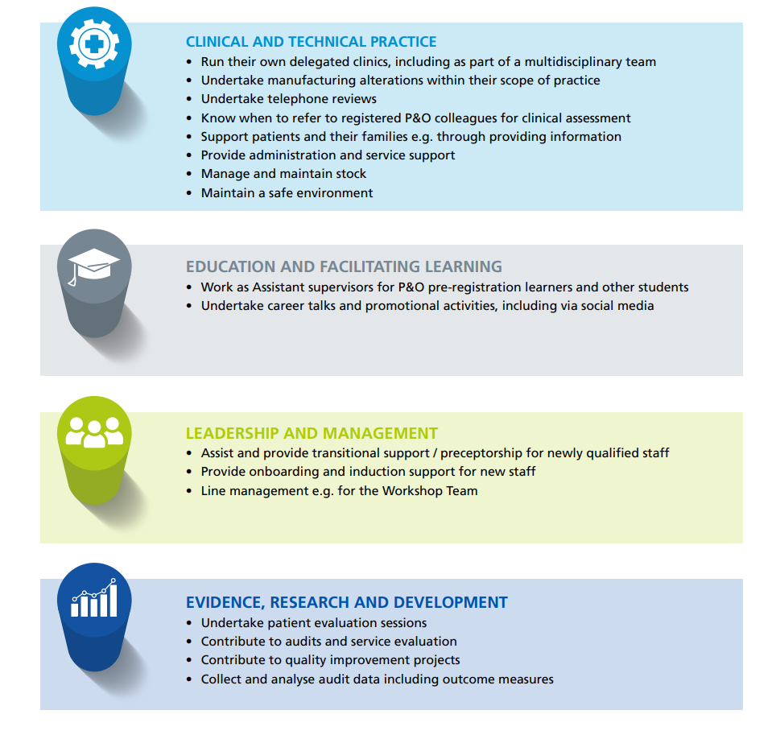
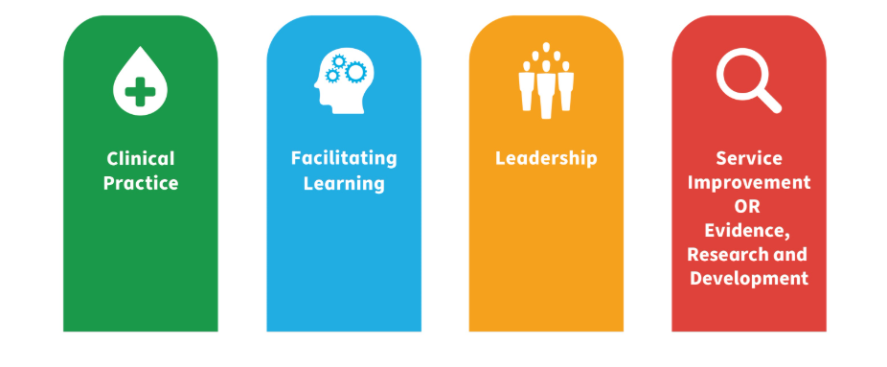
Delegation across the four pillars of practice
NHS Education Scotland, 2025
Support Workers and Technicians
Notes:
The Four Pillars of Practice are Clinical Practice, Facilitating Learning, Leadership, Evidence, research and development. This slide shares the version from NHS Education Scotland. There is some variation in terminology used in different spaces. For example, the Royal College of Occupational Therapists use the term Professional Practice to recognise their members work in many ‘non-clinical’ settings including prisons, social care, leisure centres, schools etc.
The Four Pillars of Practice are not compulsory from a regulator's perspective, but they can act as a guide when thinking about what can be delegated for the benefit of service users and to support the professional development of the workforce. On this slide, you will see a worked example, taken from a guide published by the British Association of Prosthetists and Orthotists, highlighting some of the delegated activities and roles already undertaken by support workers and technicians in patient-facing roles across the four pillars.

Slide 11
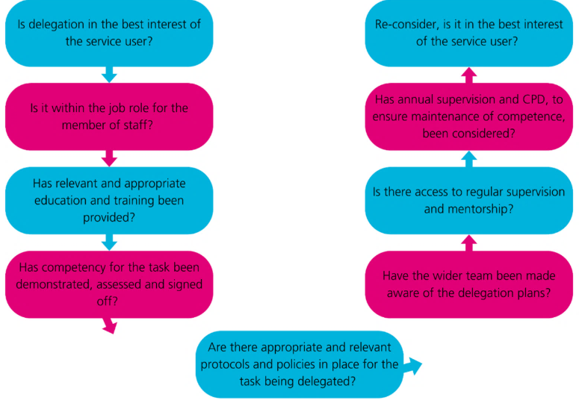
Questions to consider when thinking about delegating
British Dietetic Association, Accountability and Delegation webpage, 2025
Notes:
This slide shows an example of a professional reasoning process to support the decision to delegate – it is from the British Dietetic Association, and other professional bodies have delegation resources that address any nuances within individual professions.

Slide 12
Reflective questions and any further actions?
In what way could the four pillars of practice and questions in the previous slides support your professional judgement when delegating to others?
Are there any additional actions you would like to consider?
Identify a small number of actions you can do within the next fortnight to continue to support safe and effective delegation.

